Slide 1
Flask MongoEngine
By: Matt Freedman

Slide 2
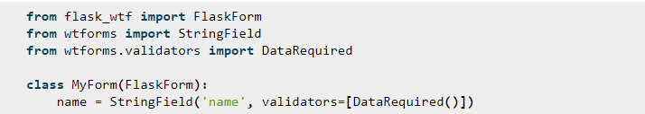
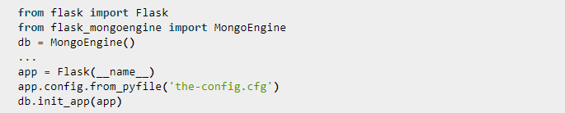
What is Flask MongoEngine?
Flask extension that incorporates the MongoEngine and controls the connection to the application that is being used with it.
Support for WTForms which is a validation form and rendering library for development with Python. Global CSRF protection (malicious app impacts the connection between the client browser and an app)
reCAPTCHA support (protects websites from spam)
Flask-WTF uses the Flask framework and can load data from request

Slide 3
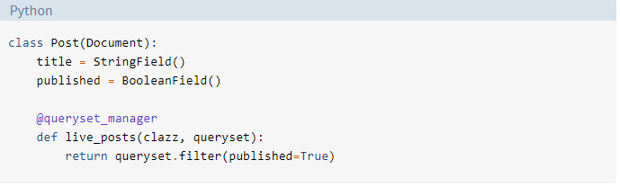
Purpose of Flask MongoEngine
MongoEngine is a Document-Object Mapper, similar to an ORM but for document databases and is used with Python as a way to define and save documents in MongoDB. This decreases coding errors.
MongoEngine allows the user to modify a queryset so that you can apply a filter to the class and only get certain objects in return.

Slide 4
Use Cases
Storing basic time oriented data, like real time counters
Using a documented database with consistency, instead of availability
The database is primarily used as a Key/Value store (User is logged in and active until they log out and the app stores all data in memory or the database itself).

Slide 5
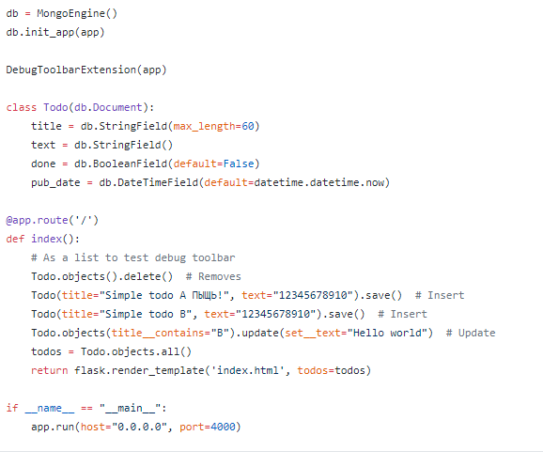

Basic Setup of MongoEngine

Slide 6
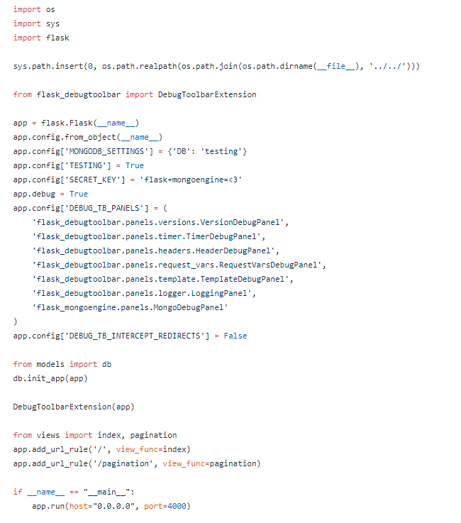
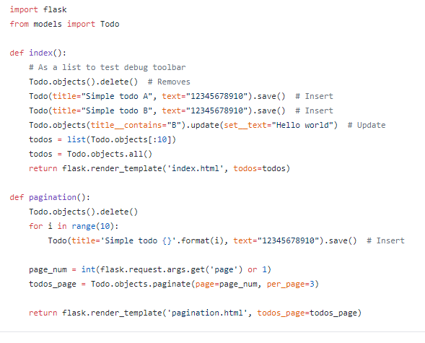
More Advanced Setup

Slide 7
Resources
http://mongoengine.org/#frameworks
https://github.com/MongoEngine/flask-mongoengine
http://docs.mongoengine.org/
https://wtforms.readthedocs.io/en/stable/crash_course.html
https://realpython.com/introduction-to-mongodb-and-python/#mongoengine

